Slide 1



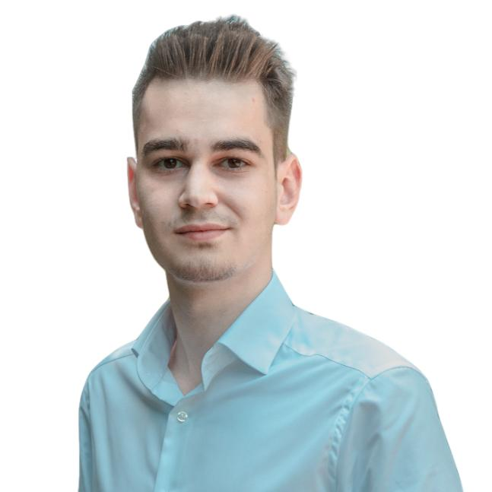

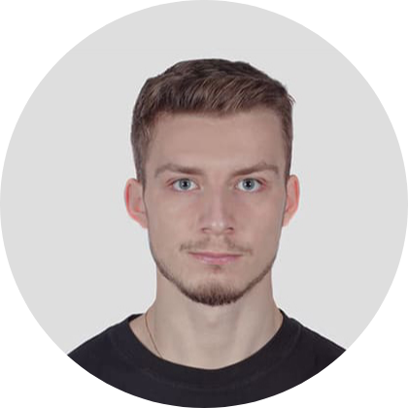
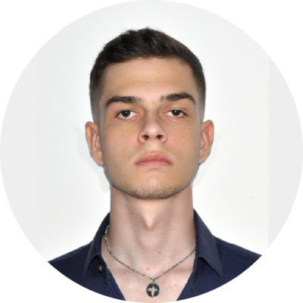

Assignment 1
Coverage & Testing
Group 7
Radu Nicolae
@VU Amsterdam
@Large Research
Gleb Mishchenko
@VU Amsterdam
@Large Research
Mateusz
Kwiatkowski
@VU Amsterdam
Daniel Halasz @VU Amsterdam
@rnicolae
@fzovpec
@dshalasz
Software Engineering Processes, June 28th, 2024
Notes:
[RN] S1 -- 1.5 min
Alright, so let’s get started.
My name is Radu Nicolae and together with my team we’ll present
assignment 1 - coverage & testing
as part of Software Engineering Processed course
We are a team of
two 2nd year CS B.Sc. students, Gleb & I, and
two 1st year CS B.Sc. students, Daniel and Mateusz
Main subject: Babel - library for internationalization.
Provides - locale-specific formatting, translations, dates, numbers, units, and many others.
We’ll discuss about
Project selection
coverage.py (imposed)
Our own coverage.py
Test enhancement
An overall, high-picture, helicoper view (spoiler, we improved the coverage by 50 statements)
Structure of the readme

Slide 2
PART 0
DO WE MEET THE
REQUIREMENTS?
‹#›
Slides available
bit.ly/2RZ7msl
Notes:
[RN]
PART 0 & PART 1 - 1 min

Slide 3
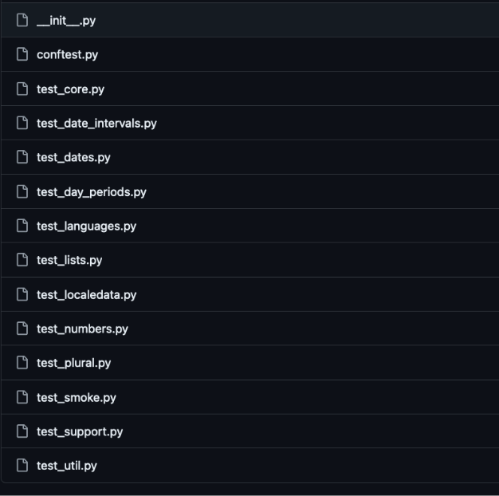
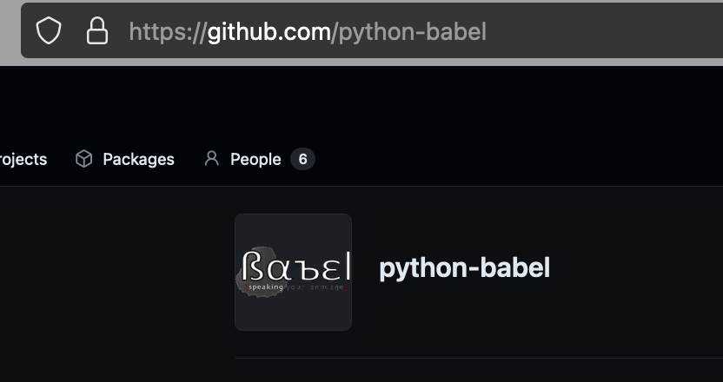
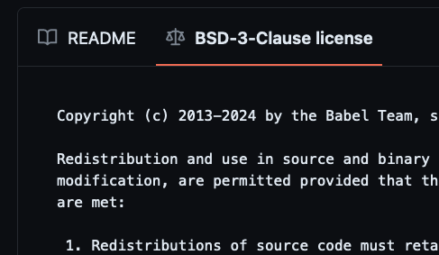
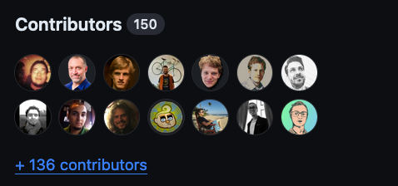
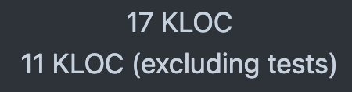
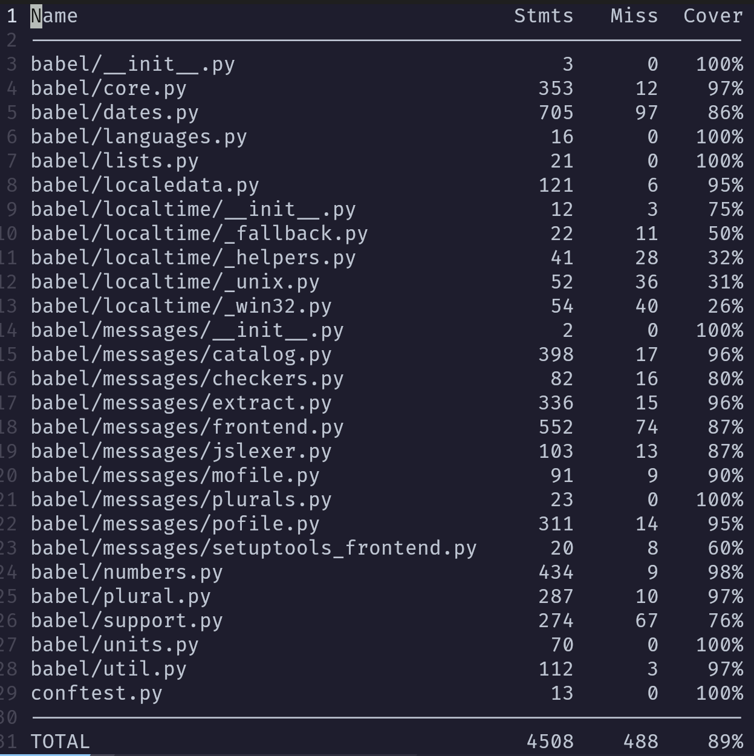
Project requirements overview
3. Auto-unit testing in PY
1. GITHUB
2. Open-source
5. >2 contributors
6. >=10KLOC
4. BRANCH COV <100%
Notes:
[RN]
Do we meet the requirements?
Well, we hope so :)
1. it’s on github
2. it is open source - free as in software, not free as in free beer
3. auto-testing with tests written in python
4. Branch-coverage <100%
5. At least two contributors - this one has 150 folks contributing to one of the largest internationalization python libs
6. More than 10,000 lines of code (aka KLOC) - ours has 17 KLOC

Slide 4
PART 1
COVERAGE.PY
(Criteria 1. Execution of existing coverage measurement tool)
‹#›
Slides available
bit.ly/2RZ7msl
Notes:
[RN]

Slide 5

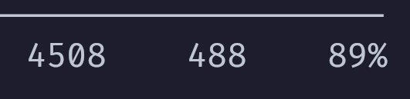
Running coverage.py
Run setup_sep from the Makefile
Sets up the python virtual environment and installs required packages
CONCLUSION: (ONLY) 89% OF STATEMENTS ARE REACHED
Run coverage_extern from the Makefile
Execute coverage with pytest. Output: .txt report
STATEMENTS
TOTAL
NOT REACHED
TODO: REDUCE!
Notes:
[RN]
We setup commands via the makefile
(makes our lives easier)
setup_set - sets up the working environment
coverage_extern - outputs .txt report
When we firstly run, we saw this report.
Zoom in: out of 4500 statements, 488 were not reached.
Let’s reduce the 488!

Slide 6
PART 2
OUR OWN
COVERAGE.PY
(Criteria 2. Instrumentation of functions for coverage measurement)
‹#›
Slides available
bit.ly/2RZ7msl
Notes:
[DH]

Slide 7
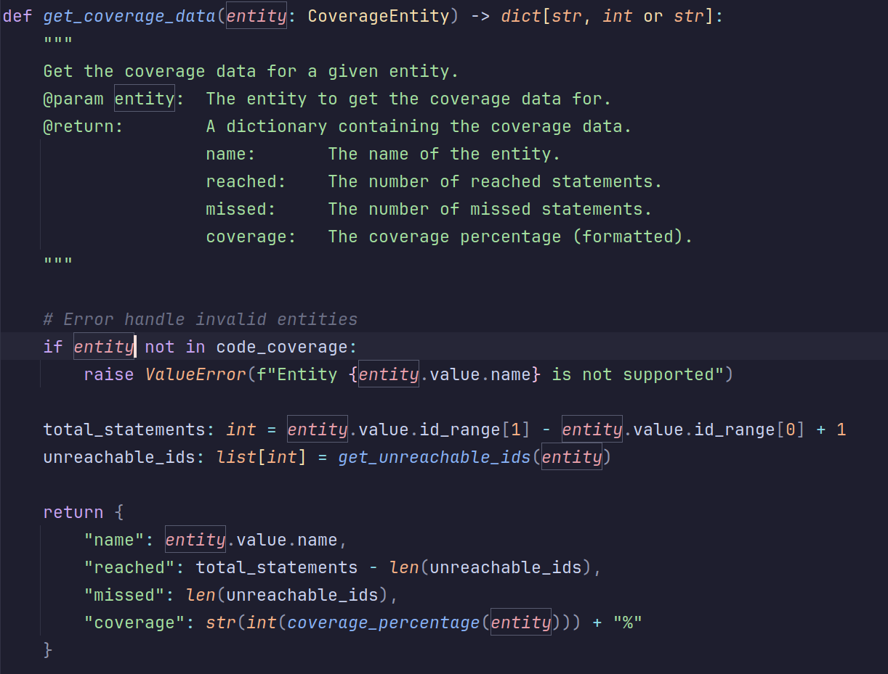
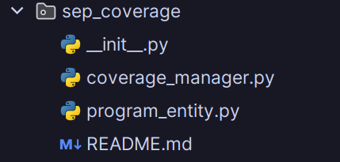

Coverage Tool
Manual instrumentation, code gets indexed manually using the instrument() function
Executed with MAKE
Built as a python package Documented in README.md
Fully documented code
Easy to use API, import the package
Notes:
Radu’s comm: Nice! Have a good presentation building, by adding animations (on click, elements appear) - see slide 5
(yet, don’t abuse of it, too much of this can make the presentation difficult to follow)
[DH] 1.5 min - slide 7 and 8
S7 + S8 = ±90s

Slide 8
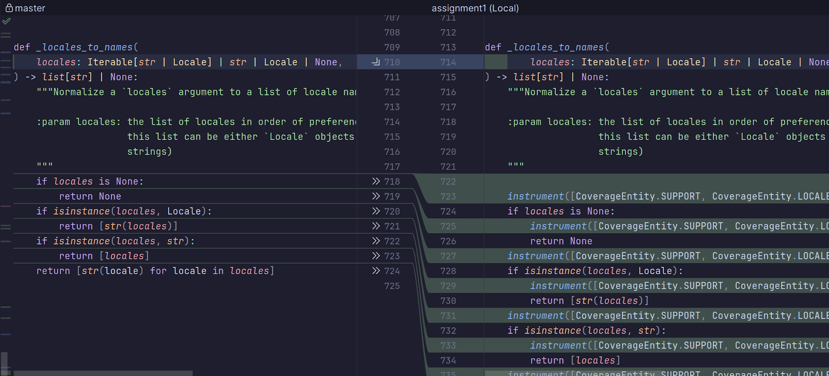
Proofs……
Daniel
Commit 2
Commit 1
Notes:
[DH]
COMM: RN: should we have commit 1 first, then commit 2? Or is there a purpose of this order?

Slide 9
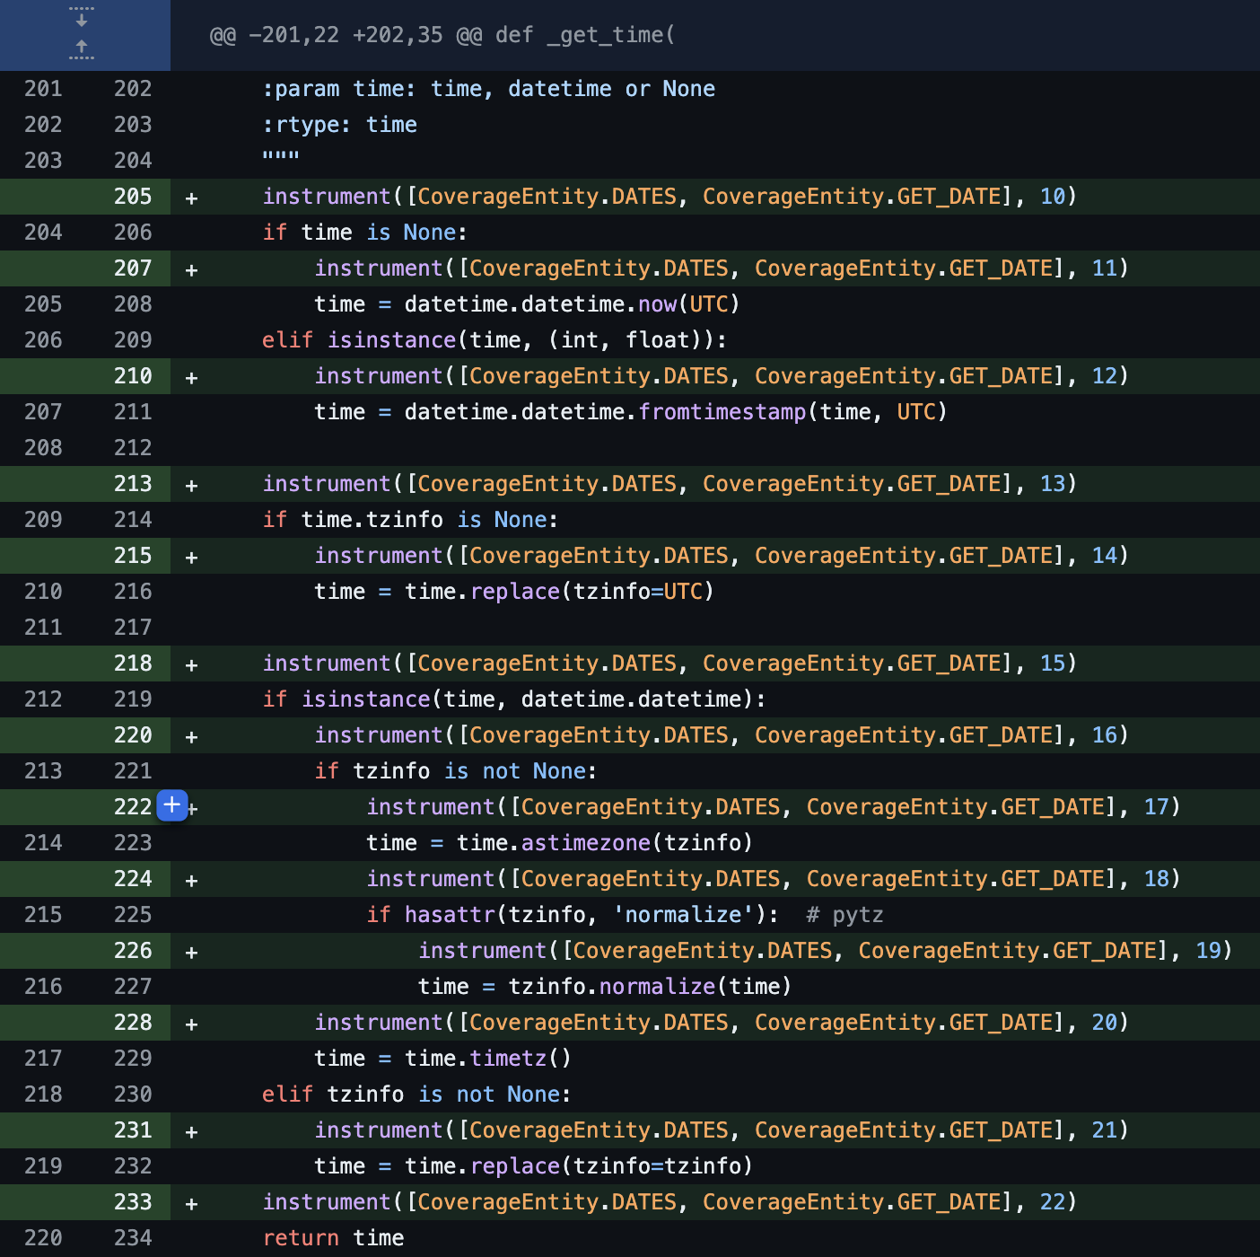
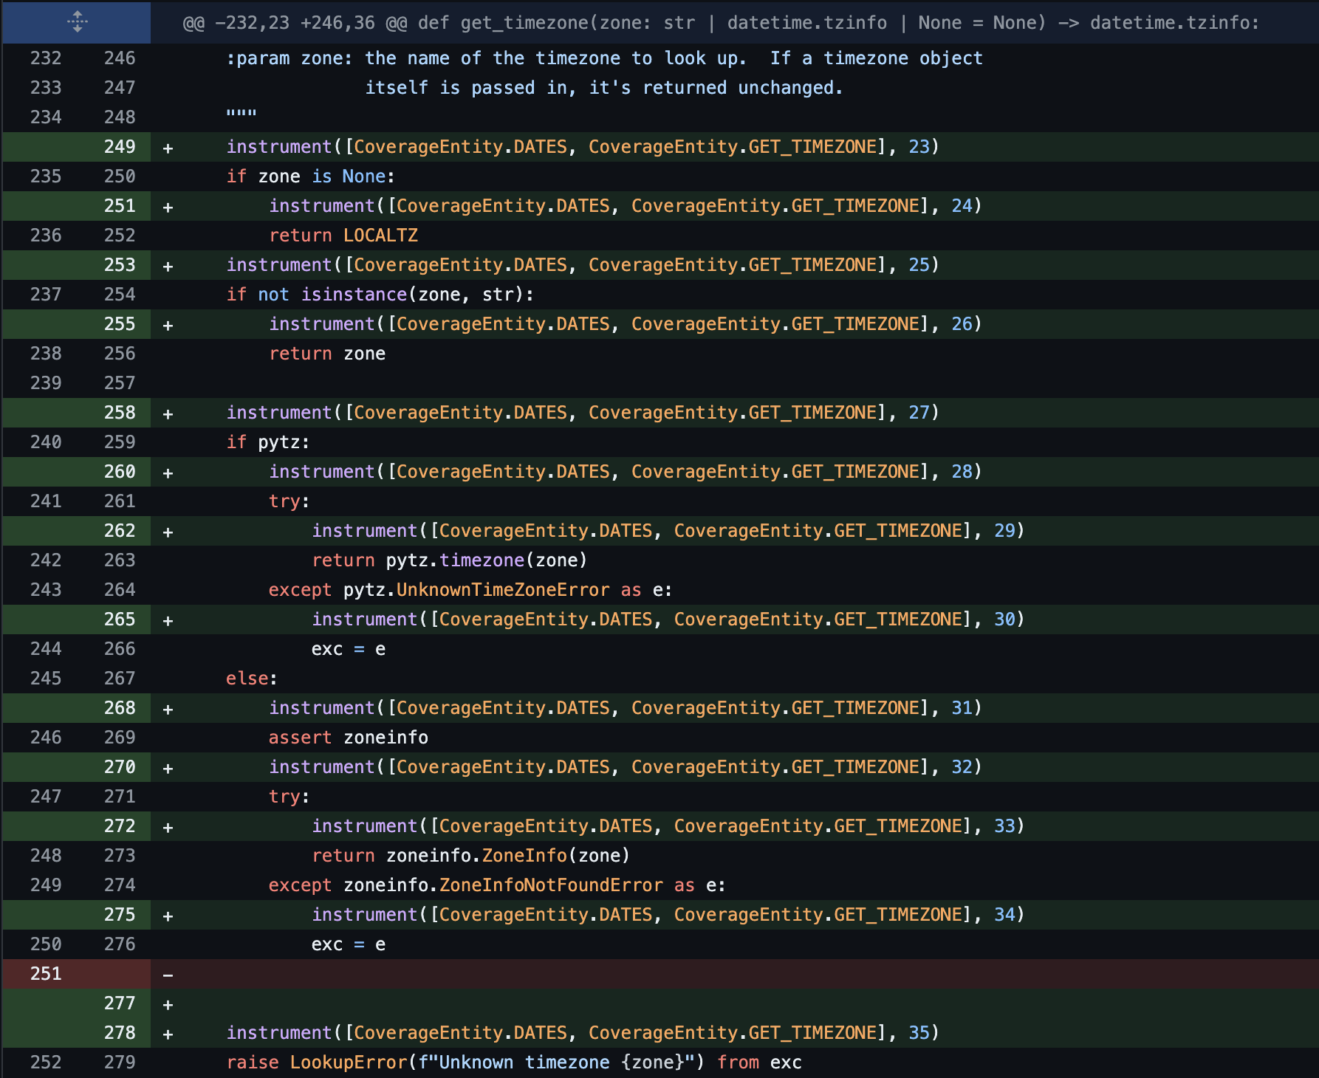
Proofs……
Commit
Gleb
Function _get_time()
Function get_timezone()
Notes:
skipped

Slide 10
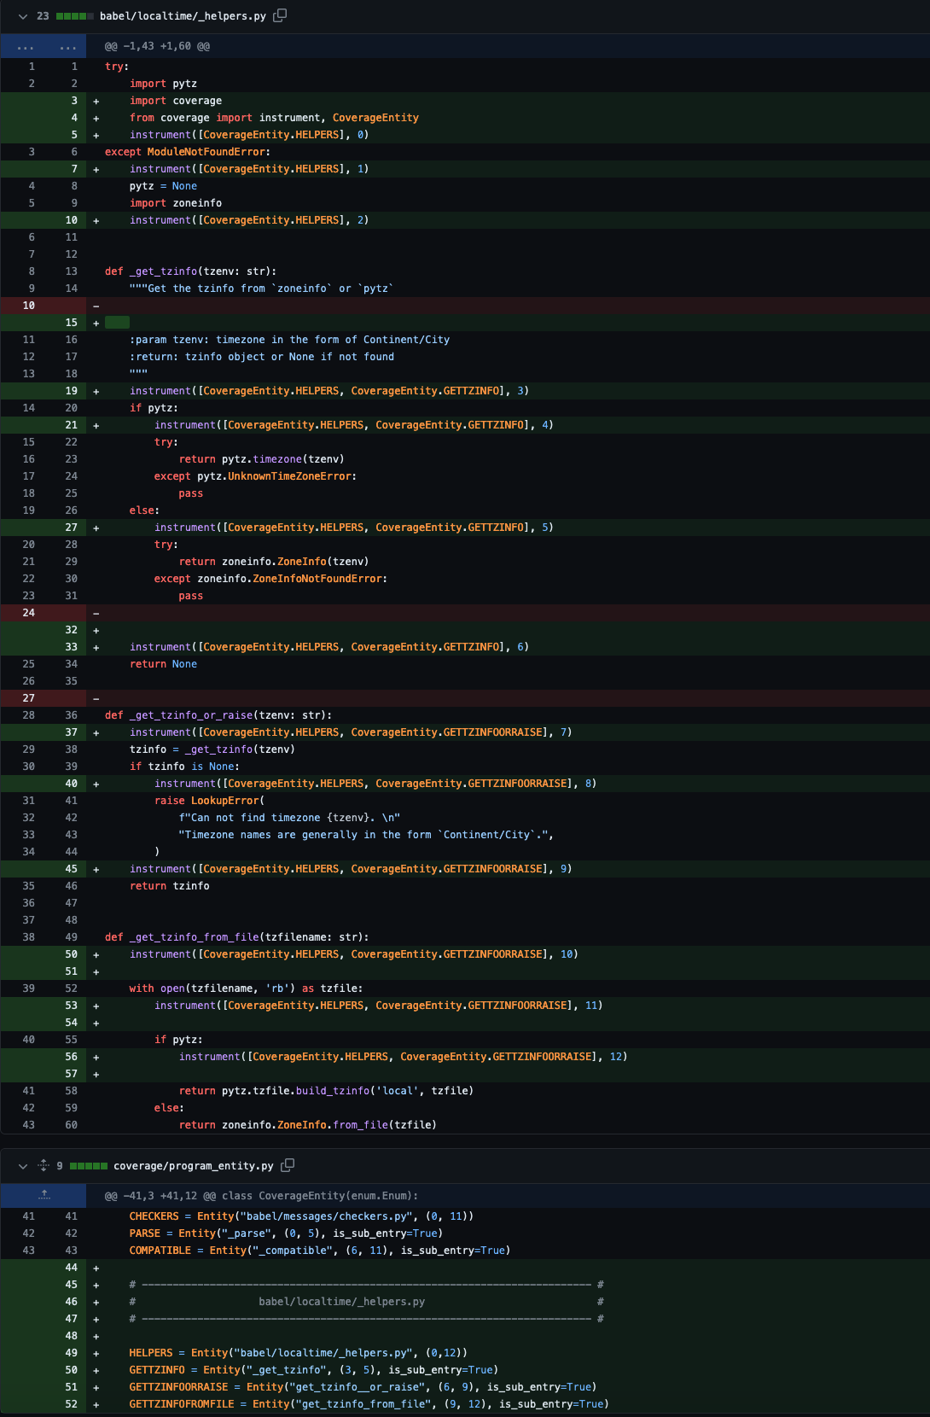
Proofs……
Mateusz
Function _get_tzinfo_or_raize()
Instrumented function _get_tzinfo()
Function _get_tzinfo_from_file()
Commit
Notes:
skipped
COMM: RN: todo remove animations

Slide 11
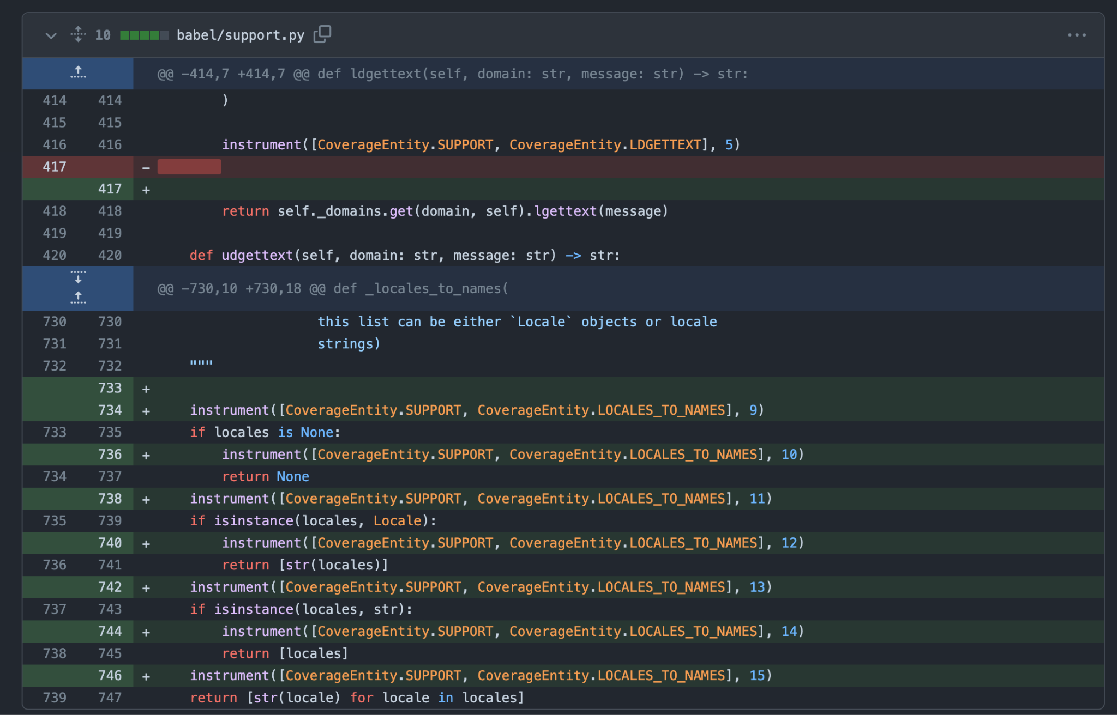
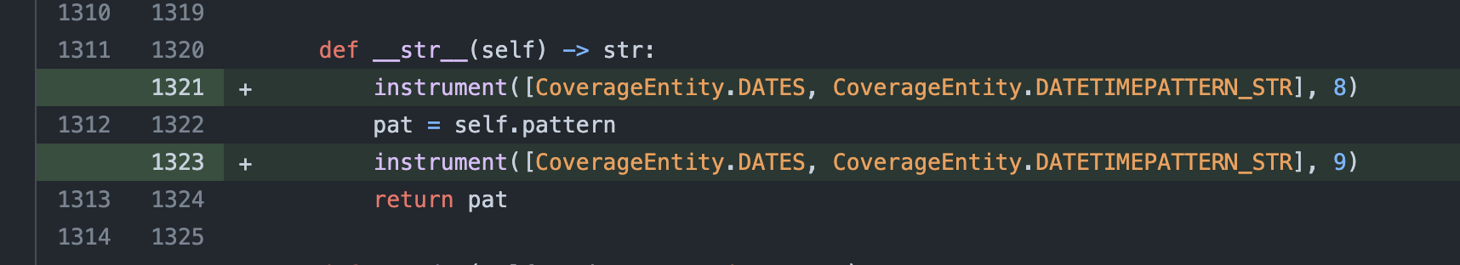
Proofs……
Radu
Function 1
Link to commit
Function 2
Notes:
skipped
[RN]

Slide 12
PART 3 - DEMO!
OUR OWN
COVERAGE.PY
(Criteria 3. Functionality of the instrumentation for coverage measurement)
‹#›
Slides available
bit.ly/2RZ7msl
Notes:
[GM] - 1min

Slide 13
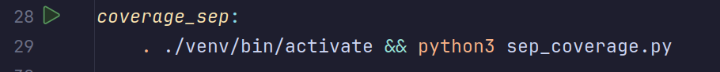
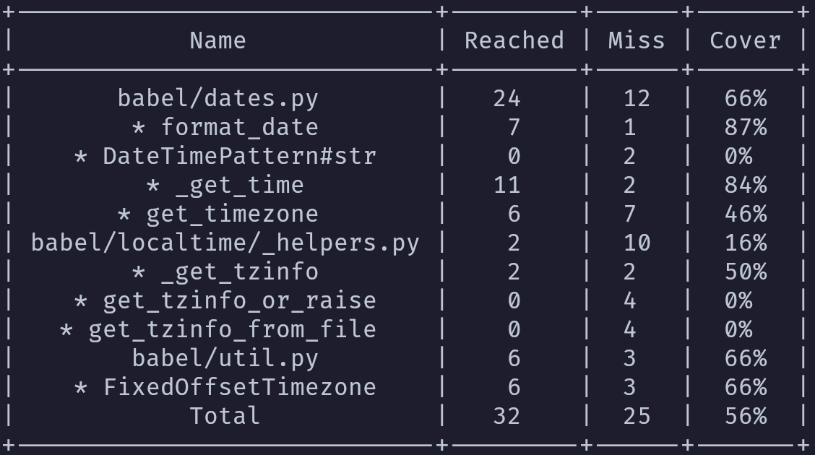
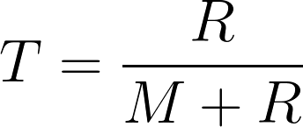
Run coverage_sep from the Makefile
OUTPUT
* = function, class or method Does not influence total Coverage
(T = total coverage, M = missed,
R = reached)
Notes:
[GM] 1 MIN

Slide 14

PART 4
- TEST
“ENCHANTMENT”
(Criteria 4. Creation/enhancement of new tests)
‹#›
Slides available
bit.ly/2RZ7msl
Notes:
[MK] - 1.5 min

Slide 15
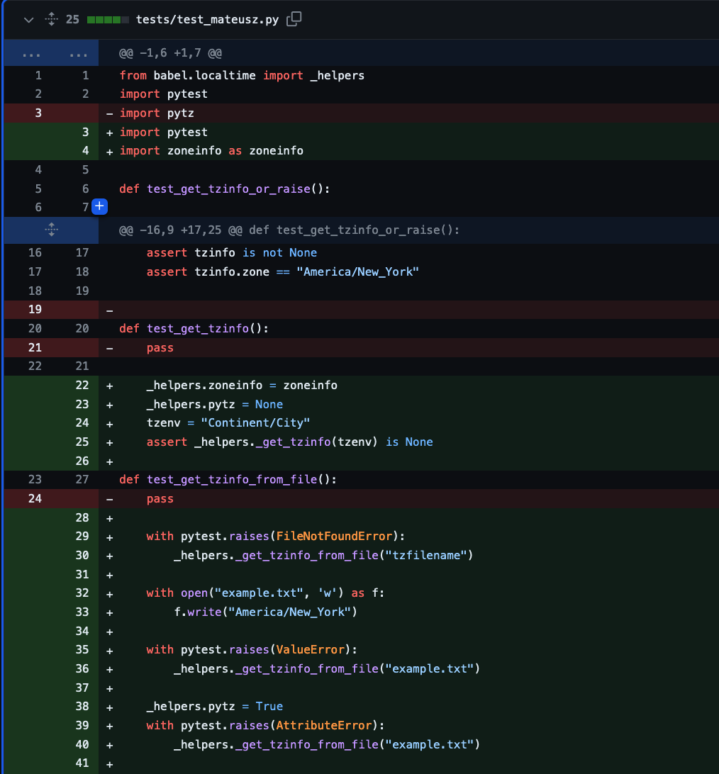
Mateusz’s Tests
Link to commit
test_get_tzinfo_or_raise()
test_get_tzinfo_from_file()
test_get_tzinfo()
Notes:
[MK]
COMM: RN: Check - are these animations fine?

Slide 16
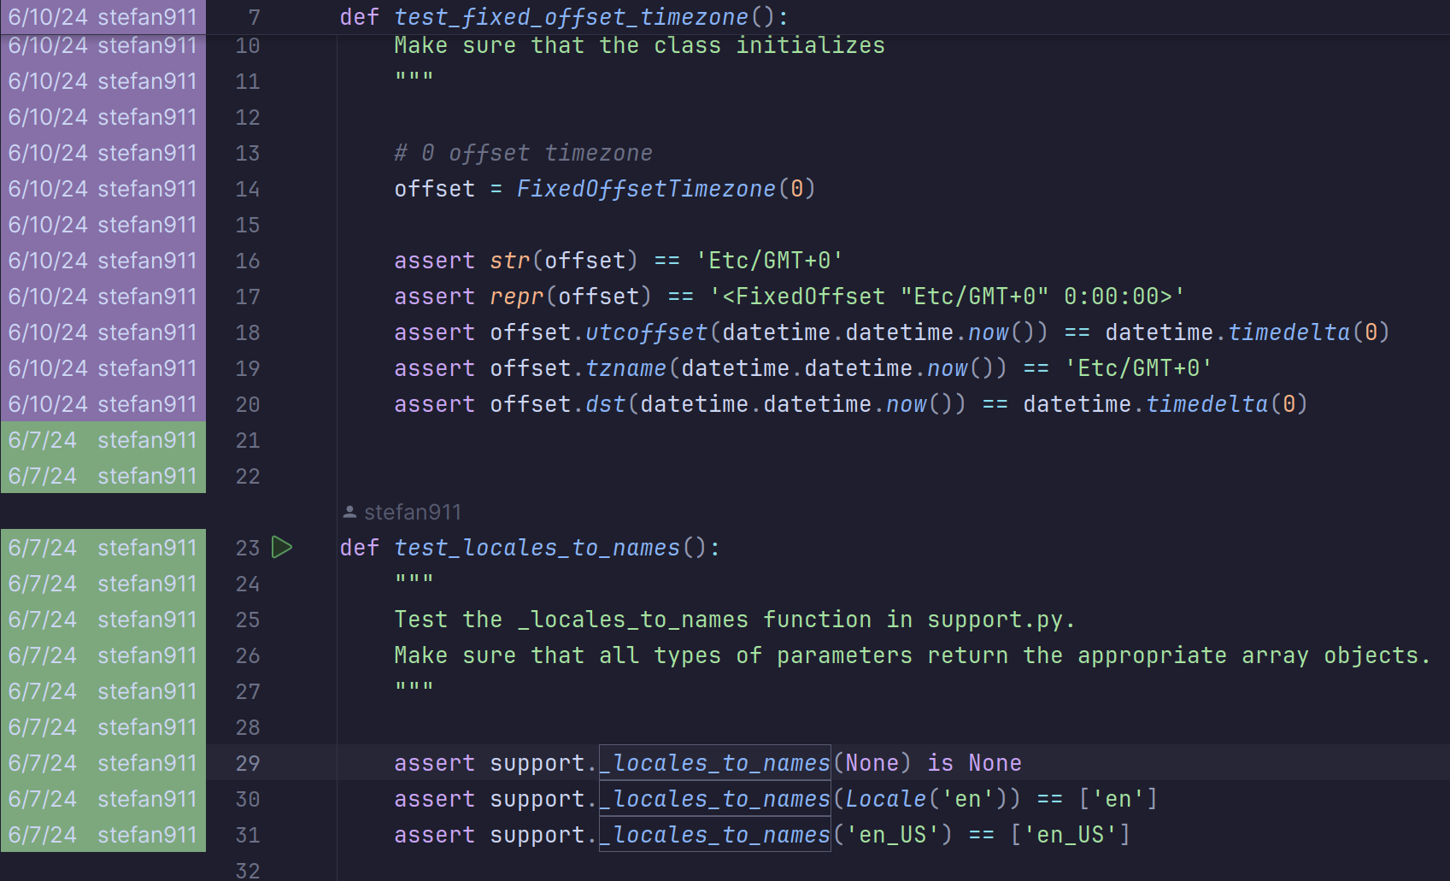
Daniel’s tests
Commit 2
Commit 1
Notes:
[skipped]
[DH]

Slide 17
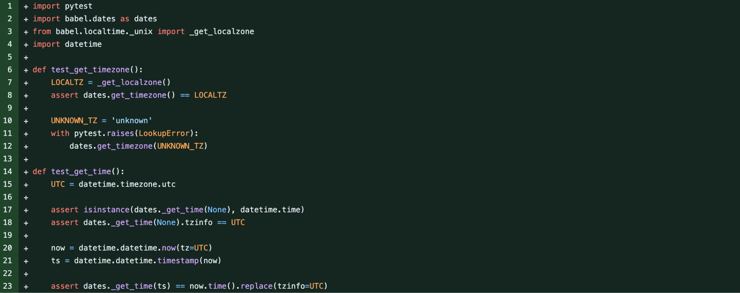
Gleb’s tests
Commit
Testing get_timezone
Testing _get_time
Notes:
[skipped]
[GM]

Slide 18
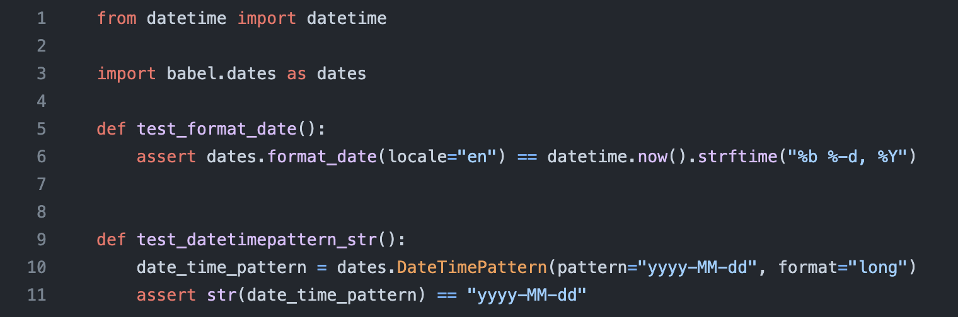
Radu’s Tests
Link to commit & file
Function 1
Function 2
Notes:
[skipped]
[RN]

Slide 19
PART 5
- TEST
DEMO -
(Criteria 5. Functionality of the new/enhanced tests)
‹#›
Slides available
bit.ly/2RZ7msl
Notes:
[MK]

Slide 20
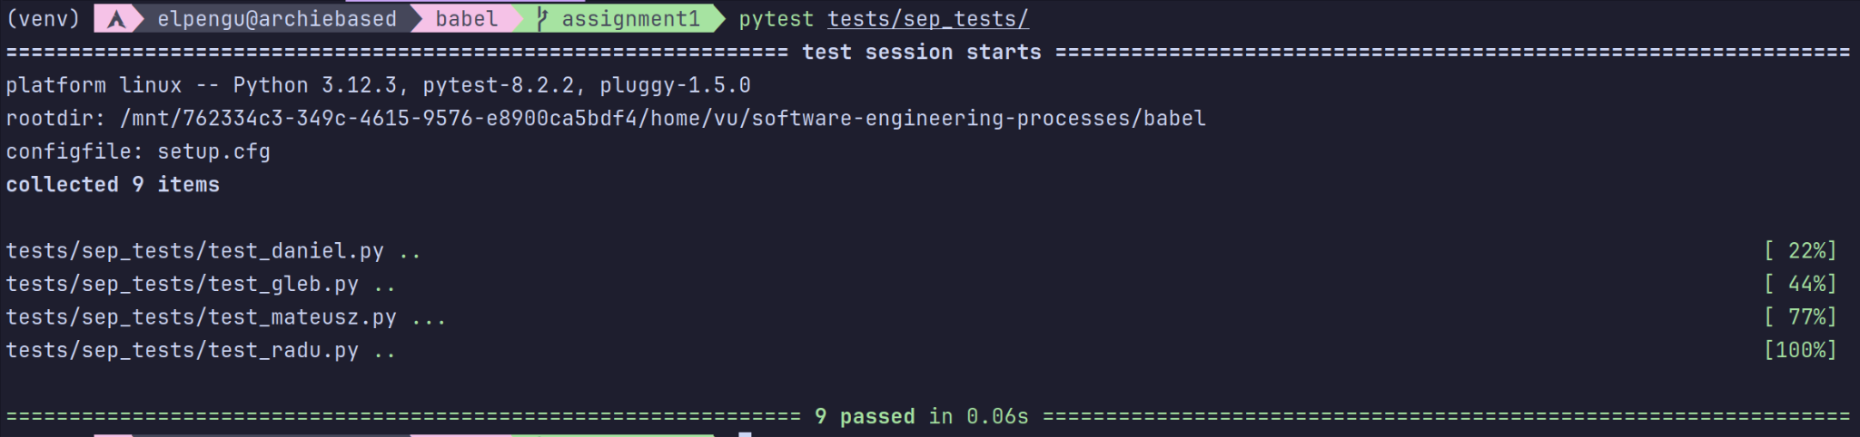
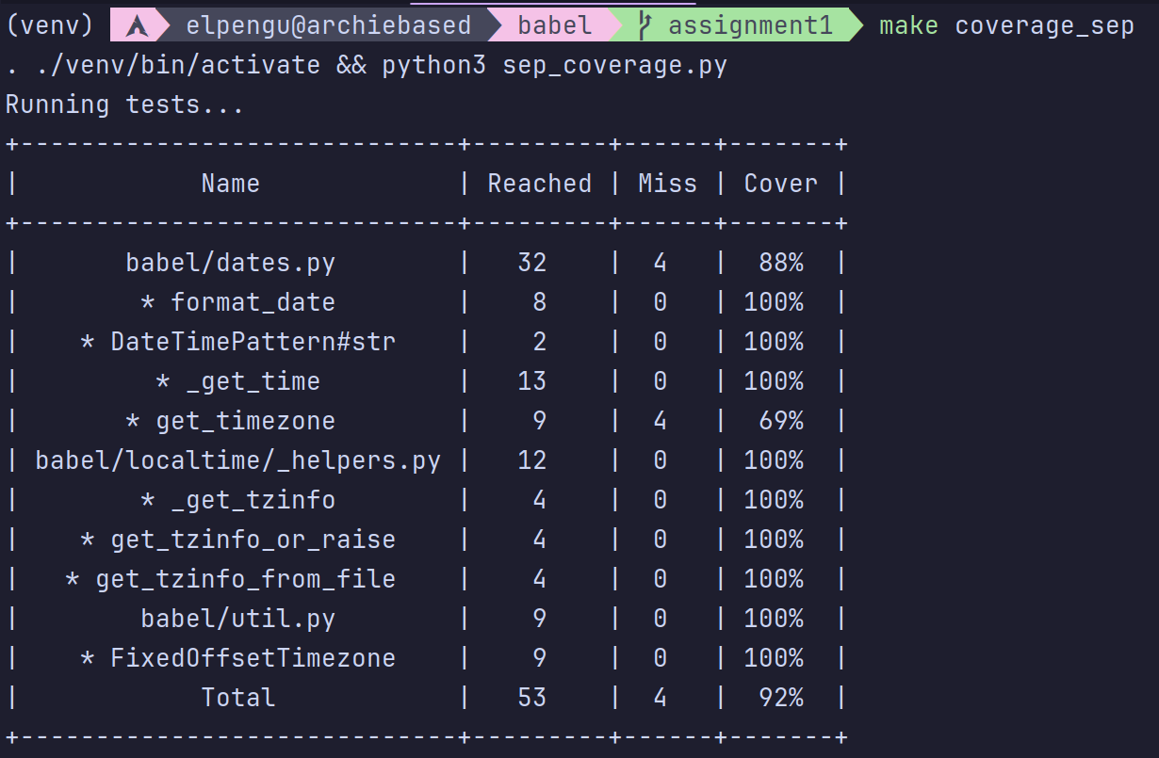
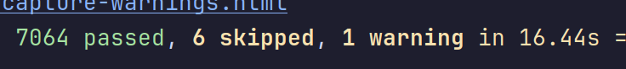
All tests passing
Progress
Personal tests
Coverage
Notes:
[MK]

Slide 21
PART 6
EVALUATION -
(Criteria 6. Effectiveness of each new/enhanced test in improving coverage)
‹#›
Slides available
bit.ly/2RZ7msl
Notes:
[MK]

Slide 22
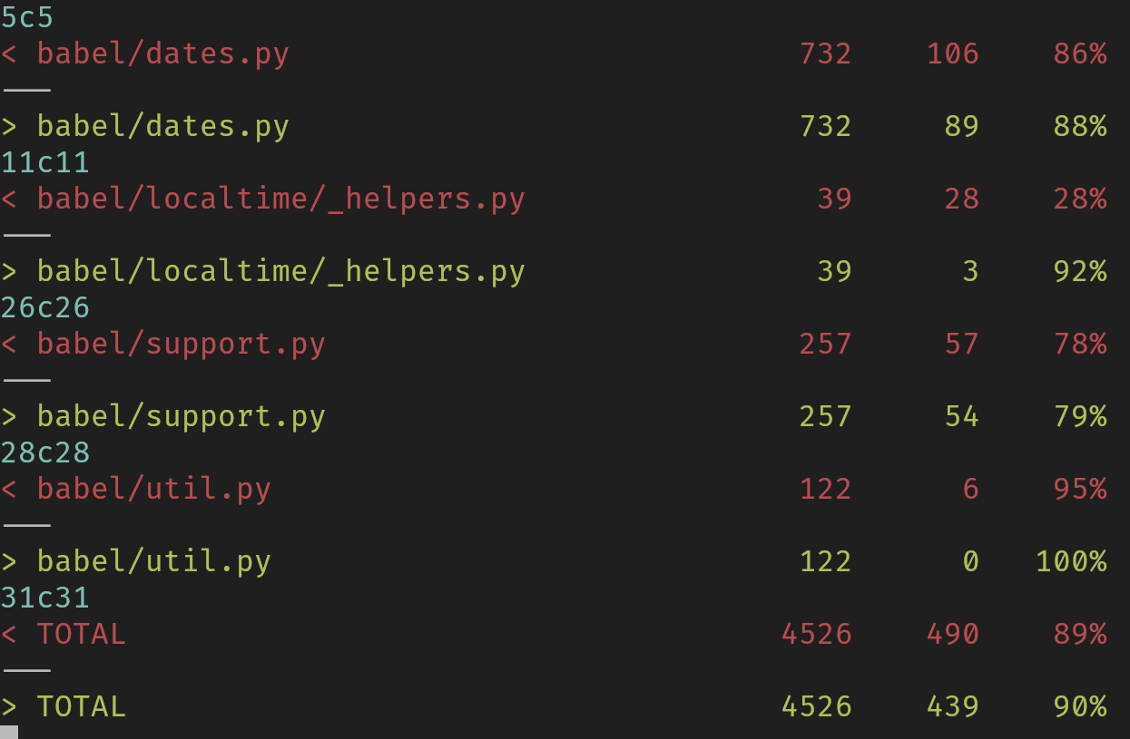
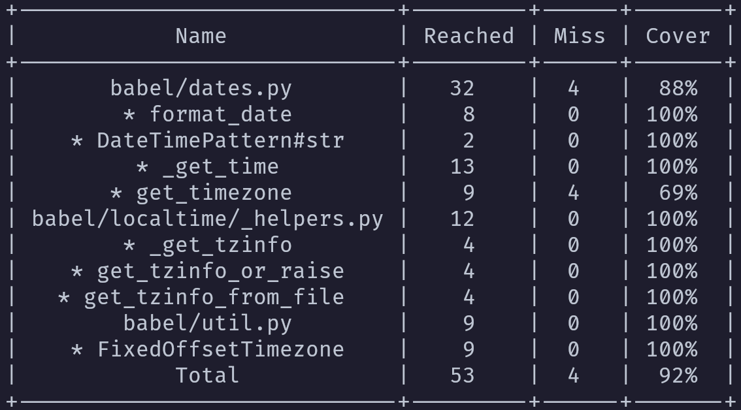
DIFF
BEFORE
AFTER

Slide 23
PART 7
OVERALL -
(Criteria 7. Overall improvement in coverage)
‹#›
Slides available
bit.ly/2RZ7msl
Notes:
[DH]

Slide 24
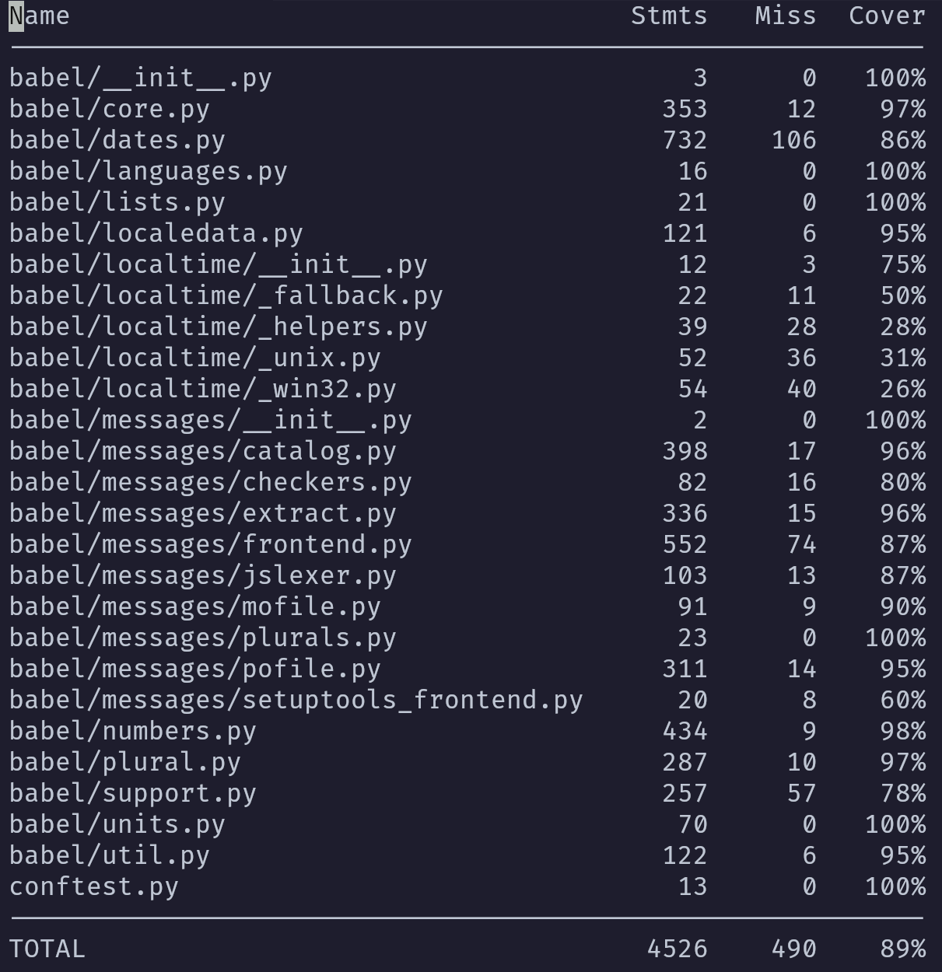
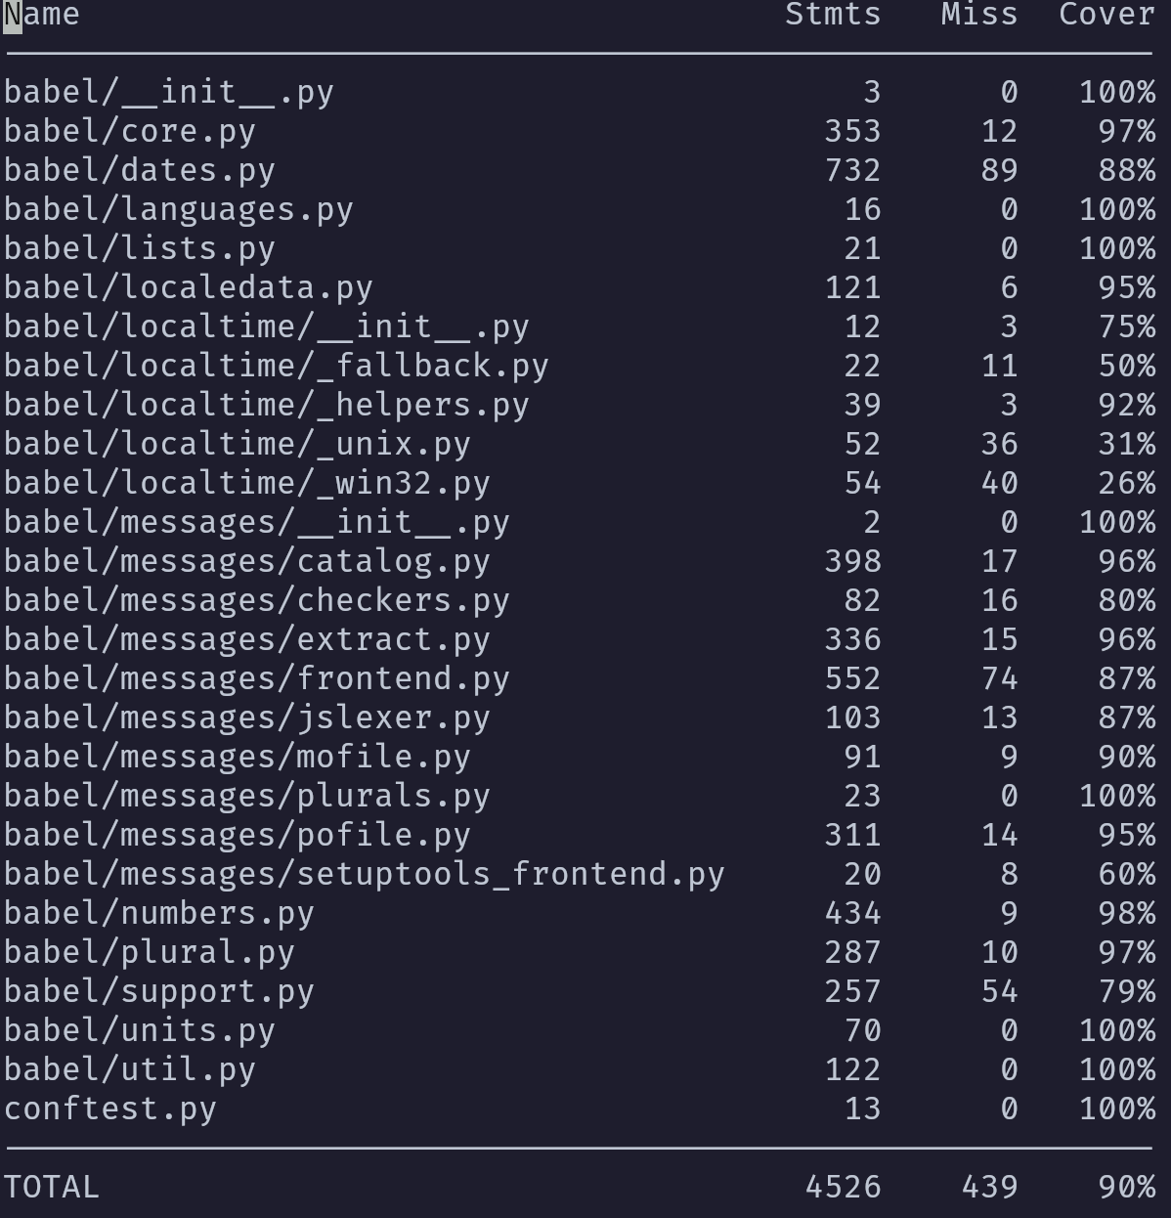
BEFORE
AFTER
TOTAL IMPROVEMENT
1.12%
51 more statements reached
Notes:
[DH]
COMM: RN: todo check - are the animations fine?

Slide 25
PART 8
README -
(Criteria 8. Organization and clarity of the report)
README.md)
‹#›
Notes:
[GM]

Slide 26
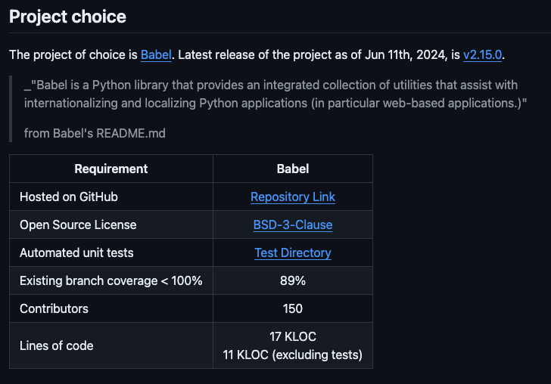
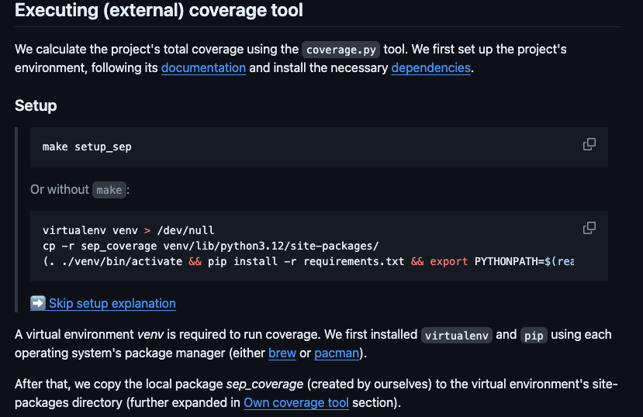
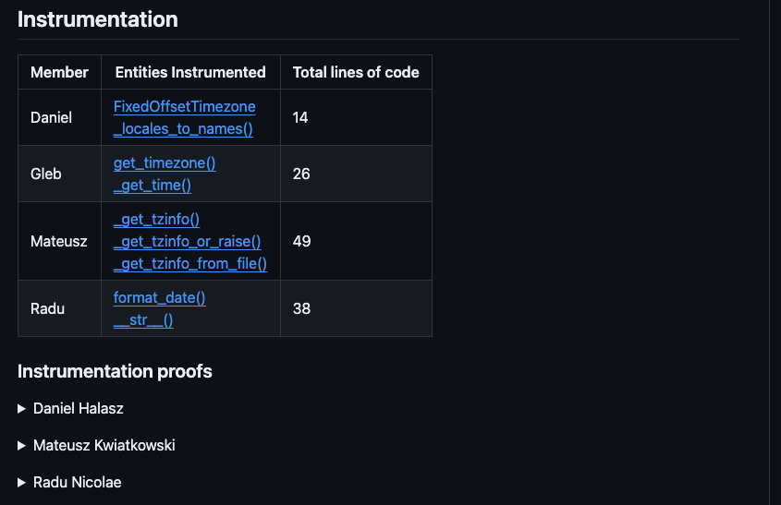
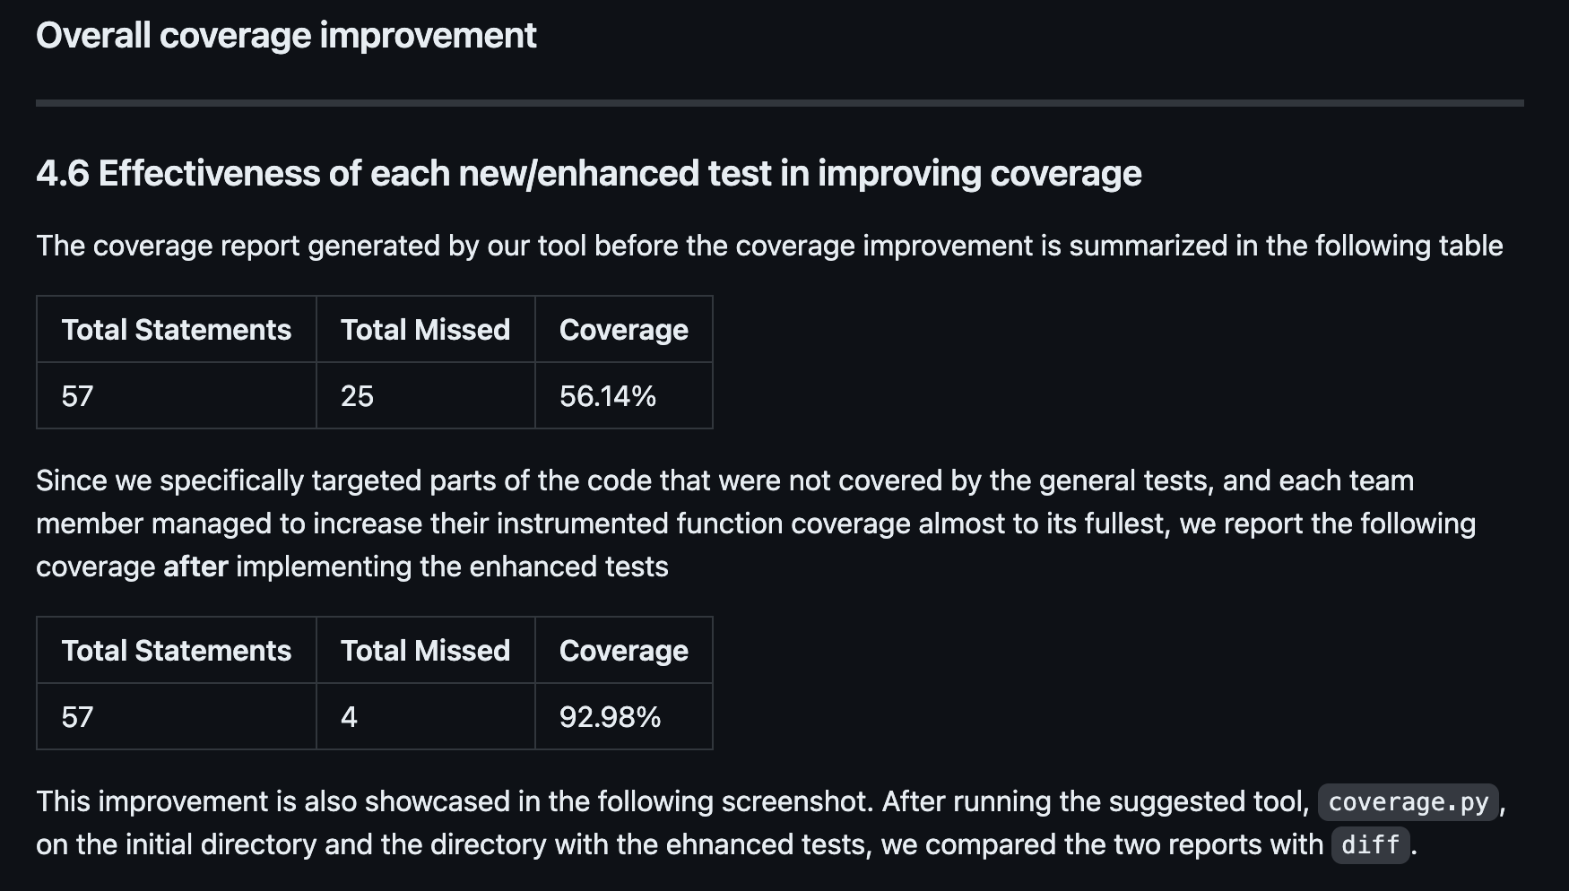
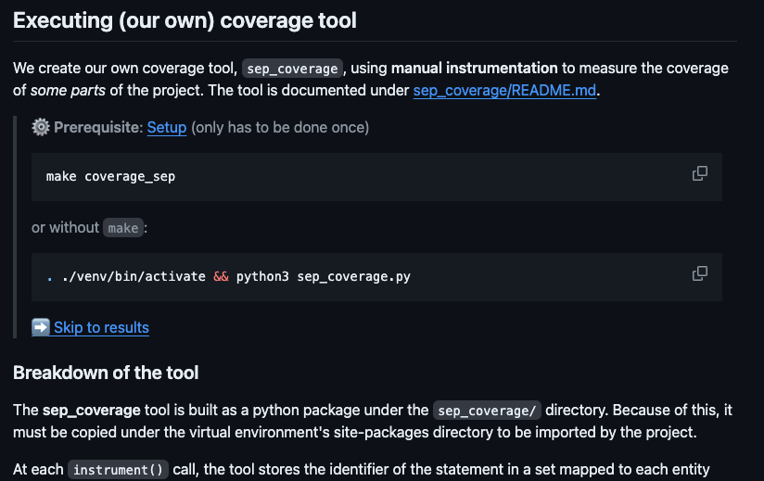
LINK
README.md
Documented:
Project Choice
How to? External coverage
How to? Our coverage tool
Instrumentation
Coverage Improvement
Notes:
[GM]
COMM: RN: I think we should just add what parts are in the readme, the titles of the sections, and briefly talk about what is where

Slide 27
TAKE-HOME
MESSAGES
‹#›
Notes:
[RN]

Slide 28
Babel is a py library for internationalization
4508 statements
instrumented
Enhanced tests
490 not reached
Delta = 51
439 not reached
Notes:
[RN]
Babel is a python library used for internationalization
Large-project,
>250 contributors,
>1 decade of existance,
Dedicated to help with internatioanl formatting rules, units, etc.
// now interpret flowchart

